Slide 1
Gene Therapy

Slide 2
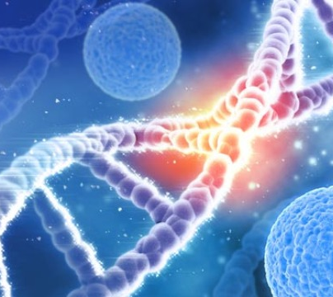
What is Gene Therapy?
Aims to treat or cure genetic abnormalities by replacing faulty genes with healthy ones. (Using the genes themselves as the treatment).
Currently this technology is being utilized in the treatment of single-gene disorders (e.g., Cystic Fibrosis, Huntington’s Disease, Sickle Cell Anaemia, and Muscular Dystrophy).

Slide 3
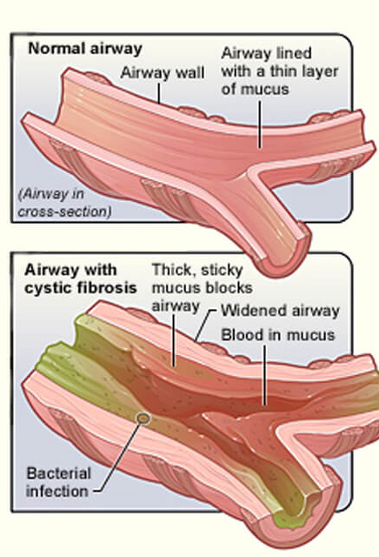
Cystic Fibrosis- A Case Study
Most common life-threatening genetic disorder among Australians of European descent.
Mostly effecting the lungs and pancreas (and sometimes the liver and reproductive organs).
Characterized by thick sticky mucus secreted by the mucous glands- which may clog the tiny air passages in the lungs trap bacteria- making a person with CF susceptible to infection.

Slide 4
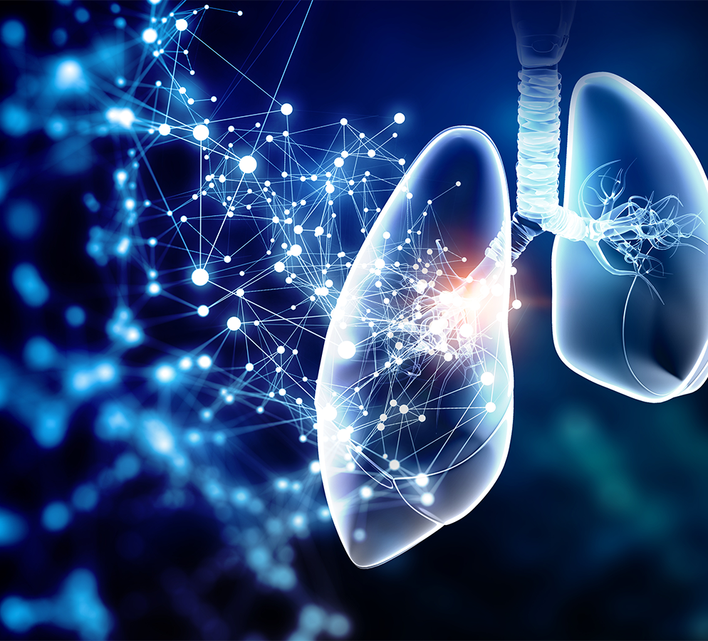
Cystic Fibrosis:
Repeated infections and continual blockages of airways may cause irreversible lung damage and shorten life expectancy.
The pancreas is also affected, preventing secretion of enzymes required for digestion.
People with CF have issue with nutrition and need to monitor their diet.

Slide 5
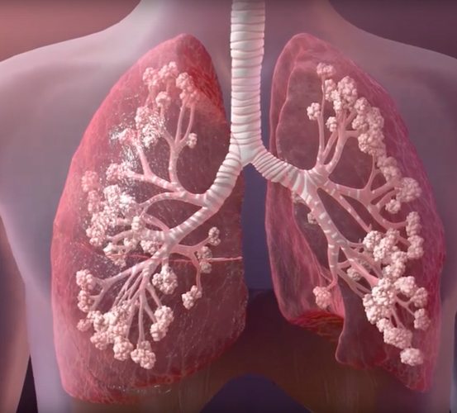
Cystic Fibrosis
Results when an individual inherits the recessive gene from both parents.
A blood sample is normally taken from the baby’s heel (2-3days after birth) to test for this condition.

Slide 6
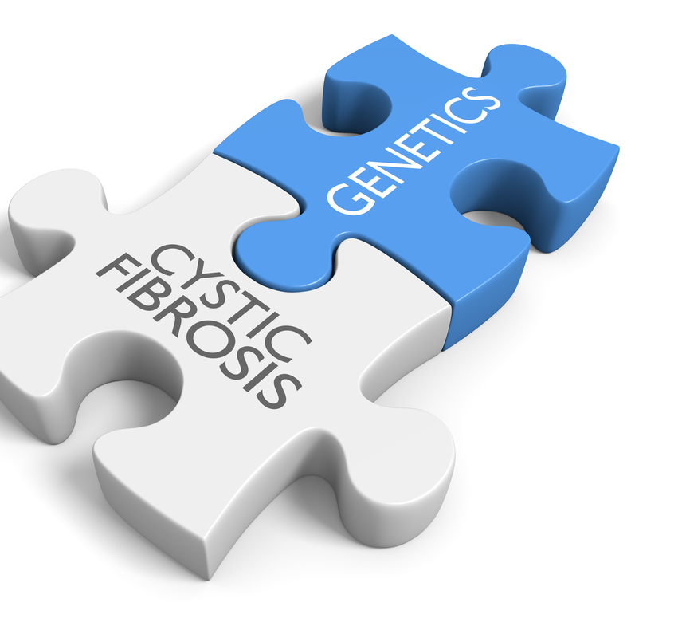
Cystic Fibrosis- Gene Therapy
The identification of Cystic Fibrosis Transmembrane Regulator (CFTR) gene in 1989 was the major step in developing the treatment.
1991, scientists successfully corrected faulty CFTR genes in cultured cells- they did this by adding normal copies of the gene to the culture.

Slide 7
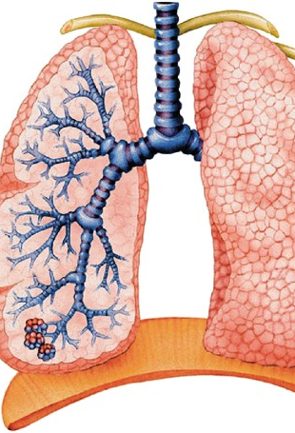
Cystic Fibrosis- Gene Therapy
This was the logical first choice to provide treatment for as it was a single gene disorder and the major organ affected (the lungs) were relatively easily to access to provide treatment too.
The disease is also slow to progress, meaning they can treat the condition in infancy before serious lung damage has yet to occur.

Slide 8
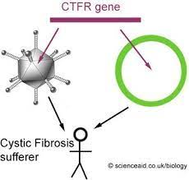
Cystic Fibrosis- Gene Therapy
The first human trial for gene therapy treatment of CF was in 1993
Researchers used a modified common cold virus (recombinant technology) to act as the vector to carry normal CFTR cells to the airways and lungs.
This trail was concerned more with health risks and safety.
Trials are still underway in testing this treatment.

Slide 9
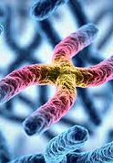
Huntington’s Disease- A Case Study
Huntington’s is another single-gene disorder.
It is caused by a mutation on Chromosome 4 called IT15
The symptoms rarely appear before the age of 40.

Slide 10
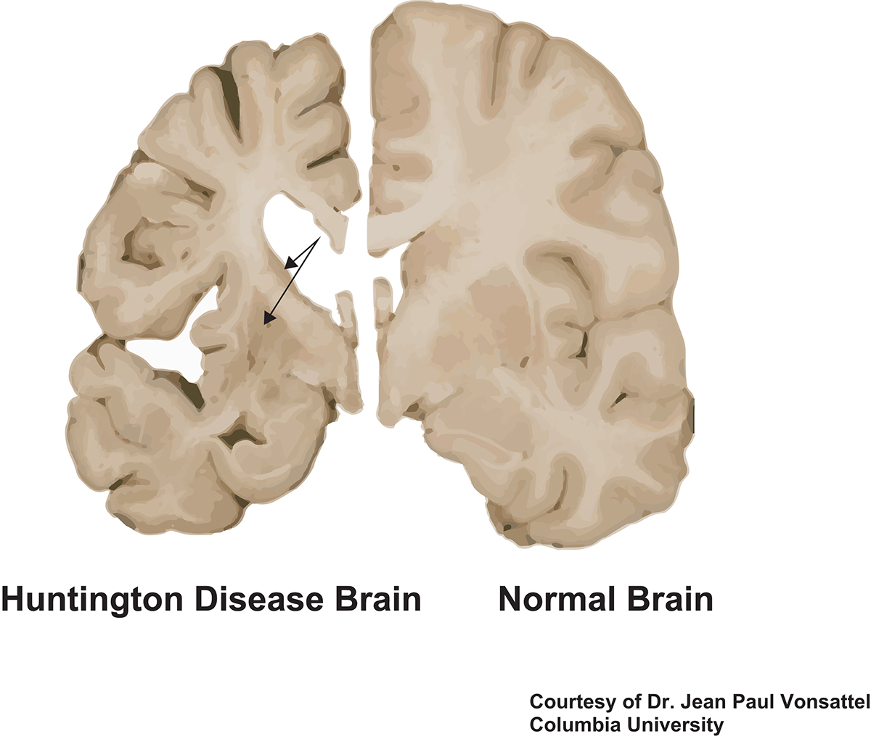
Huntington’s Disease:
Mutated form of the Huntington Protein- results in brain nerve cells being damaged- causing physical, mental and emotional changes
Characterised by occasional unintentional flailing movements of arms and legs and difficulty making voluntary movements of limbs
They also suffer from progressive dementia and the loss of ability to think clearly.

Slide 11
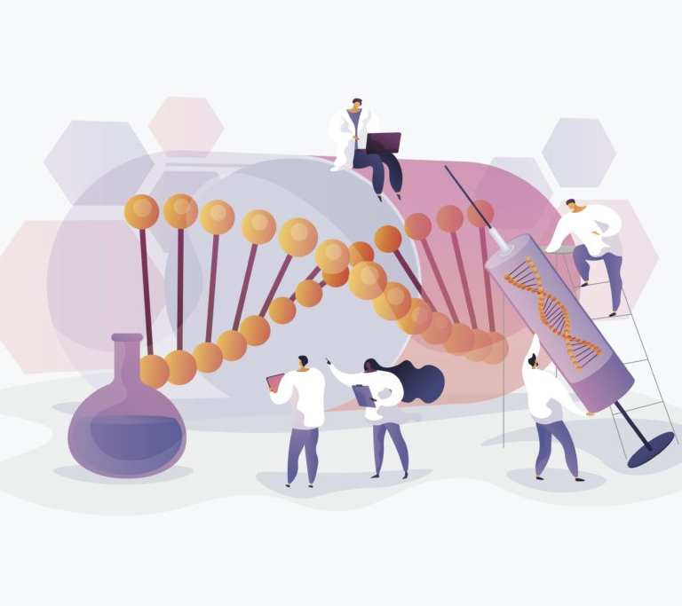
Huntington’s Disease- Gene Therapy
Research in the USA on mice has indicated that Gene Therapy for Huntington’s disease could be effective in humans
Research in France has experimented with a modified virus to deliver the corrective gene into brain cells that boosts a natural shield against the effects.
This research has been conducted on rats and primates and the positive results encourage trailing on humans.

Slide 12
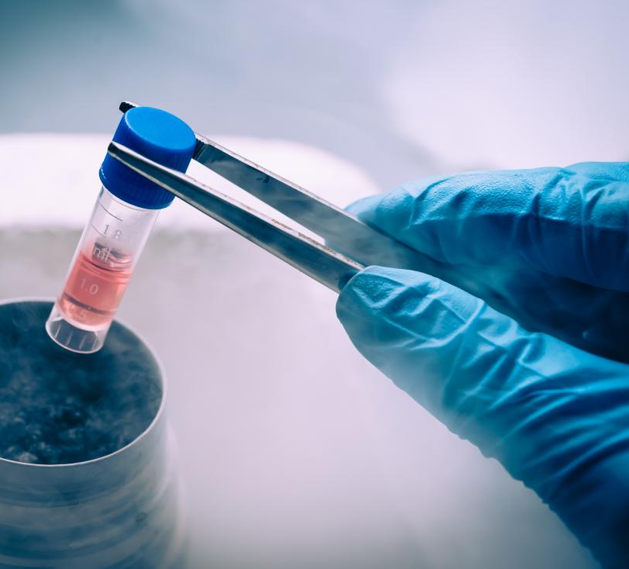
Cell Replacement Therapy
Stem cells are undifferentiated cells that are capable of repeated mitotic divisions for long periods of time- with the ability to become specialised.
This makes them ideal for producing replacement tissues.
Any disorder involving the loss or injury of normal cells is a potential candidate for stem cell replacement therapy.

Slide 13

Cell Replacement Therapy
This type of therapy has generated the most interest in restoring the nervous system- especially due to widespread occurrence of neurodegenerative disorders such as Parkinson’s and Alzheimer’s diseases
The most attractive method of restoring brain function in Parkinson’s is the replacement of dying neurons with healthy neuronal tissue- with the healthy tissue not only surviving but establishing connections with nearby neurons.
The pilot studies in this have been using human embryonic stem cells. Making this a controversial treatment and of ethical debate.

Slide 14

Tissue Engineering
Stem cells are increasingly being used for tissue engineering.
The primary objective being to restore healthy tissues or organs to patients- eliminating the need for transplants.
Early research used cells from the patient but in many cases (particularly with Genetic Diseases) it was not practical.
In other cases, the organ was harvested, and not enough healthy cells could be extract to use.
Stem cells overcame both these problems

Slide 15
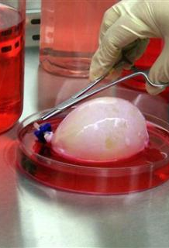
Tissue Engineering
This requires an abundant supply of disease-free cells of specific types.
These cells also need to be induced on a scaffold of natural or synthetic material to produce 3-D tissues.
These scaffolds serve as a template for tissue growth and need to have high pore sizes that enable cells to grow while at the same time allow for diffusion of nutrients throughout the whole structure.

Slide 16
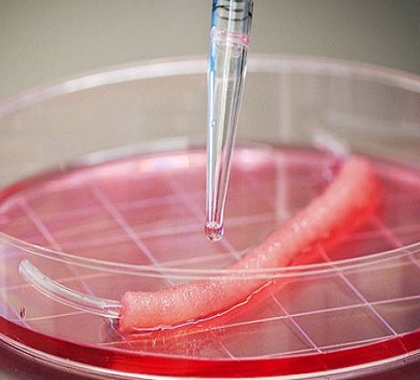
Tissue Engineering:
These scaffolds need to be biodegradable so that they can be absorbed by the tissues and not need to be surgically removed.
The rate that the scaffold degrades needs to match the rate of tissue formation.
This is so the scaffold can provide support whilst cell matrices are being established.

Slide 17
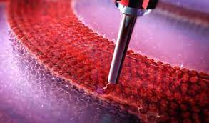
Tissue Engineering:
Once the scaffold has been devised- the most suitable stem cells need to be cultured.
These are seeded onto the scaffold which then enables further cell growth and proliferation
This cell-covered scaffold is then implanted into the patient at the site where new tissue is required.
As the cells continue to grow and divide, the scaffold breaks down, in some cases, to be absorbed.

Slide 18
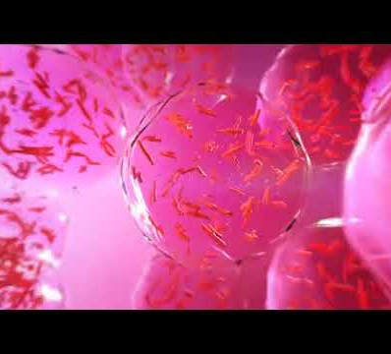
Tissue Engineering:
Such engineering techniques are currently being used to develop bone, skin, cartilage and adipose tissue.

Slide 19
But wait there is more:
https://jeopardylabs.com/play/have-you-been-paying-attention-19

